Slide 1

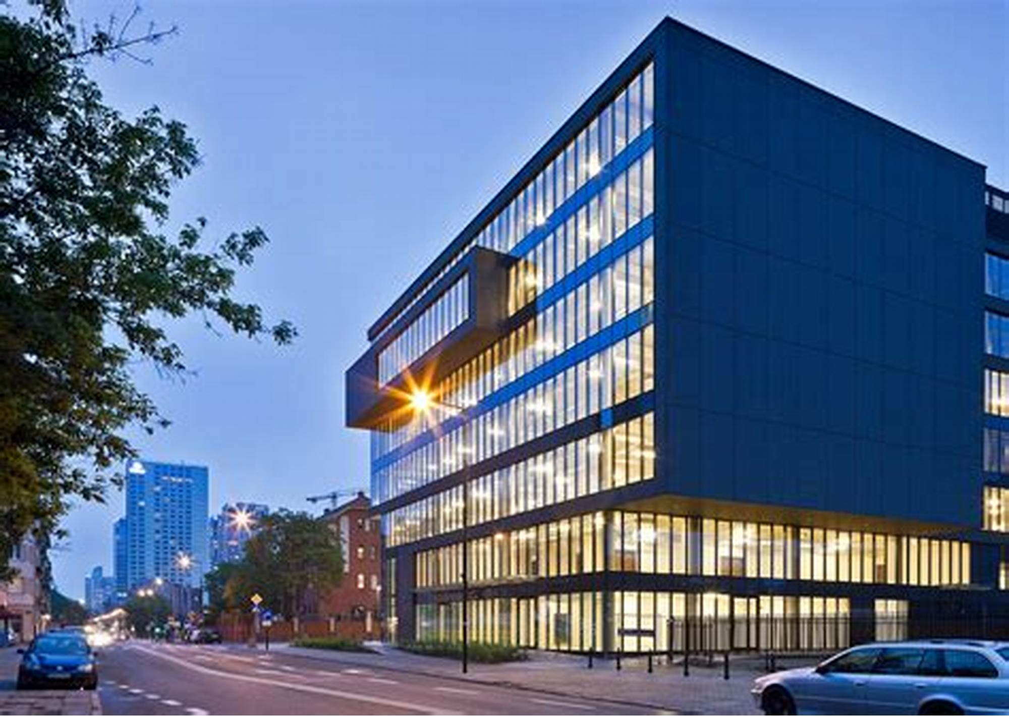
BUSINESS PROFILE
PRAZAMANA SafeTIC LLP
“Ensuring Safety”
www.machinessafety.com
Page 01 of 16

Slide 2

TABLE OF CONTENTS
USP pf Prazamana Safe TIC LLP fences
Key Projects
Key Customers
www.machinessafety.com
Page 02 of 16

Slide 3
Unique Selling Points (USP) of Prazamana Safe TIC LLP Safety Fences
100% Made in India and Designed by TUV certified Safety Experts:
Our safety fences are proudly manufactured in India, ensuring high-quality standards and supporting local industries. This also allows for faster delivery times compared to imported products.
Customized Sizes Available:
We offer a range of customized sizes to meet the specific needs of different projects and applications. This flexibility ensures that our fences can be tailored to your exact requirements.
Tested and CE Marked:
Our safety fences are rigorously tested and CE marked under machinery directive 2006/42/EC as per EN ISO 14120:2015 by TUV, guaranteeing compliance with international safety standards and providing peace of mind regarding their reliability and effectiveness.
Easy and Modular Installation and Ergonomically Safe Designs:
Designed with user convenience in mind, our fences feature easy installation processes and ergonomically safe designs, reducing installation time and enhancing overall user safety.
Faster Deliveries:
Being manufactured locally in India, our products are readily available for faster deliveries, minimizing delays and ensuring timely completion of projects.
Customized Color Combinations and Durable Product:
We offer a variety of colour combinations for our safety fences, allowing you to choose colours that match your brand, enhance visibility, or meet specific aesthetic preferences.
Constructed with high-quality materials to withstand harsh environments and heavy use, ensuring long-lasting performance and reliability
www.machinessafety.com
(machi
Page 03 of 16

Slide 4
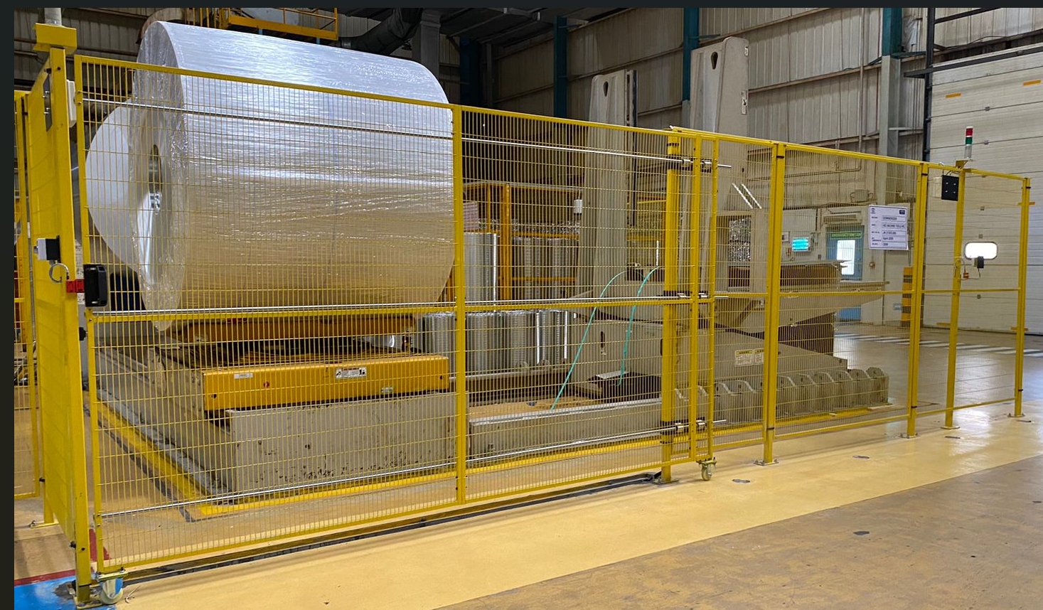
KEY PROJECTS DELIVERED
M/s. CANPACK INDIA Pvt. Ltd.
Start and release
New products releases
Certificates and Achievements
www.machinessafety.com
Page 04 of 16

Slide 5
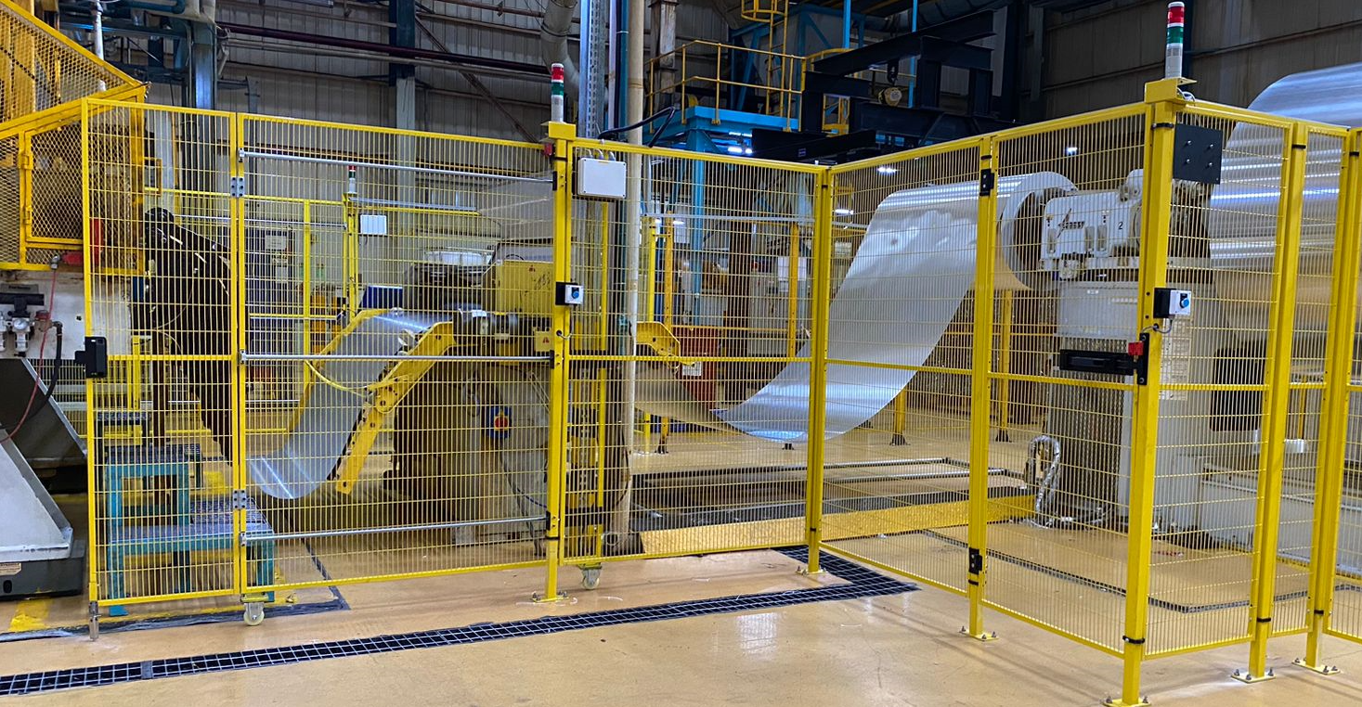
KEY PROJECTS DELIVERED
M/s. CANPACK INDIA Pvt. Ltd.
Start and release
New products releases
Certificates and Achievements
www.machinessafety.com
Page 05 of 16

Slide 6
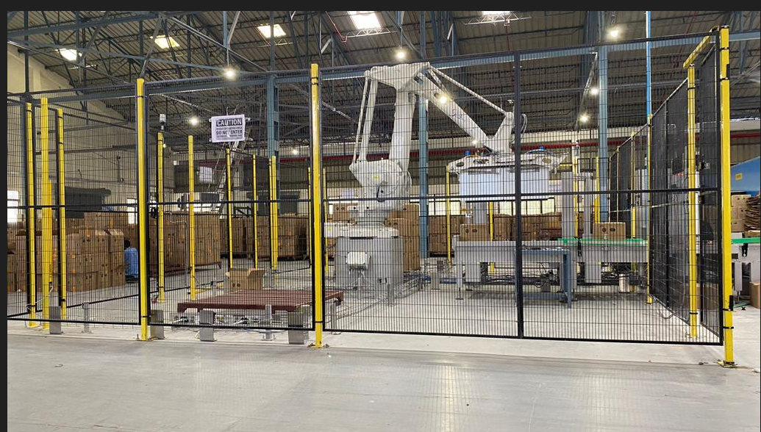
KEY PROJECTS DELIVERED
M/s. Godrej
Start and release
New products releases
Certificates and Achievements
www.machinessafety.com
Page 06 of 16

Slide 7
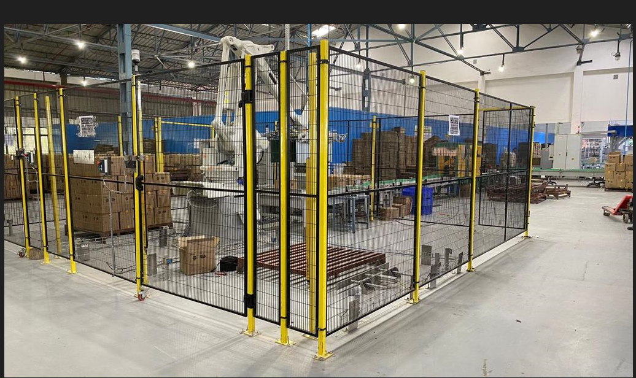
KEY PROJECTS DELIVERED
M/s. Godrej
Start and release
New products releases
Certificates and Achievements
www.machinessafety.com
Page 07 of 16

Slide 8
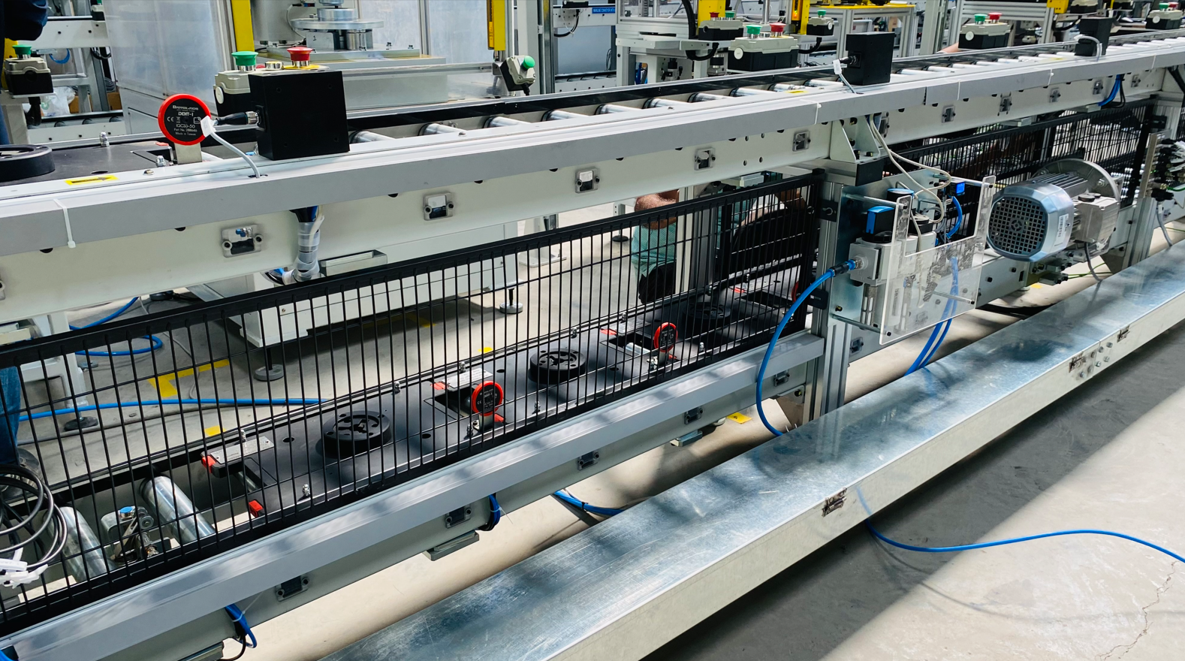
KEY PROJECTS DELIVERED
M/s. Jendamark
Start and release
New products releases
Certificates and Achievements
www.machinessafety.com
Page 08 of 16

Slide 9
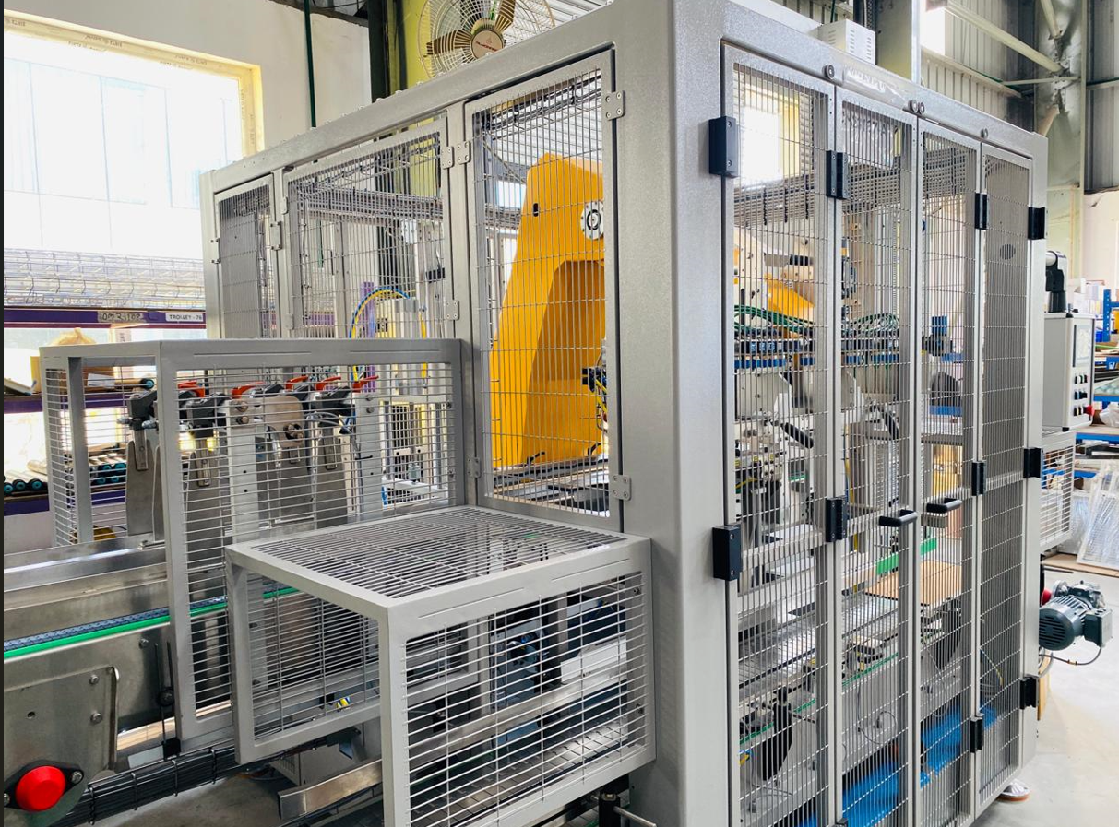
KEY PROJECTS DELIVERED
M/s. Jendamark
Start and release
New products releases
Certificates and Achievements
www.machinessafety.com
Page 9 of 16

Slide 10
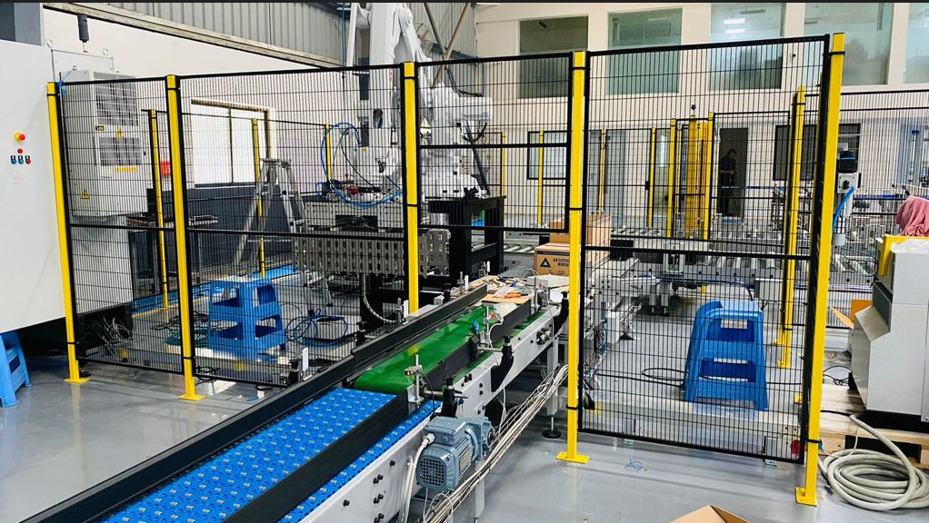
KEY PROJECTS DELIVERED
M/s. Xolertics
Start and release
New products releases
Certificates and Achievements
www.machinessafety.com
Page 10of 16

Slide 11
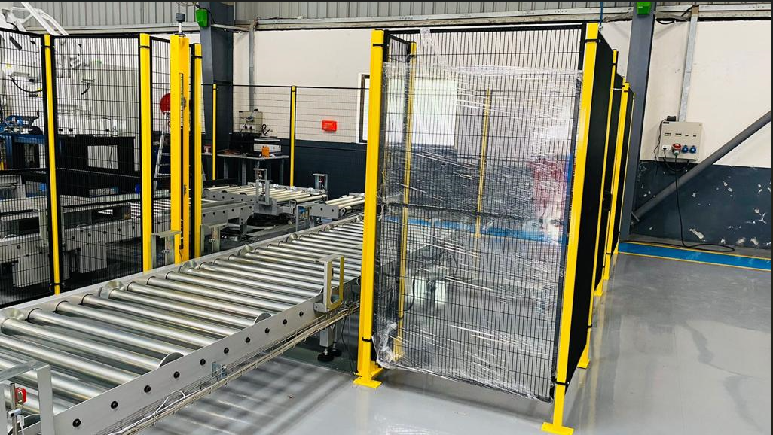
KEY PROJECTS DELIVERED
M/s. Xolertics
Start and release
New products releases
Certificates and Achievements
www.machinessafety.com
Page 11 of 16

Slide 12
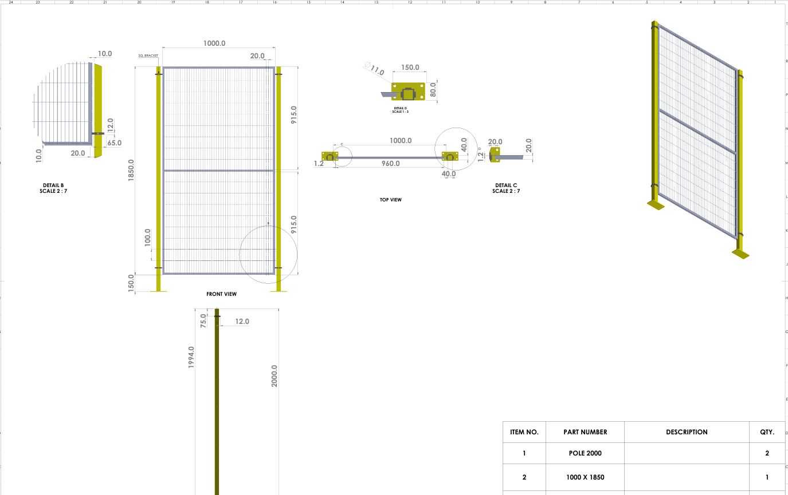
DETAILED VIEW OF THE PANEL POST
Start and release
New products releases
Certificates and Achievements
www.machinessafety.com
Page 12 of 16

Slide 13
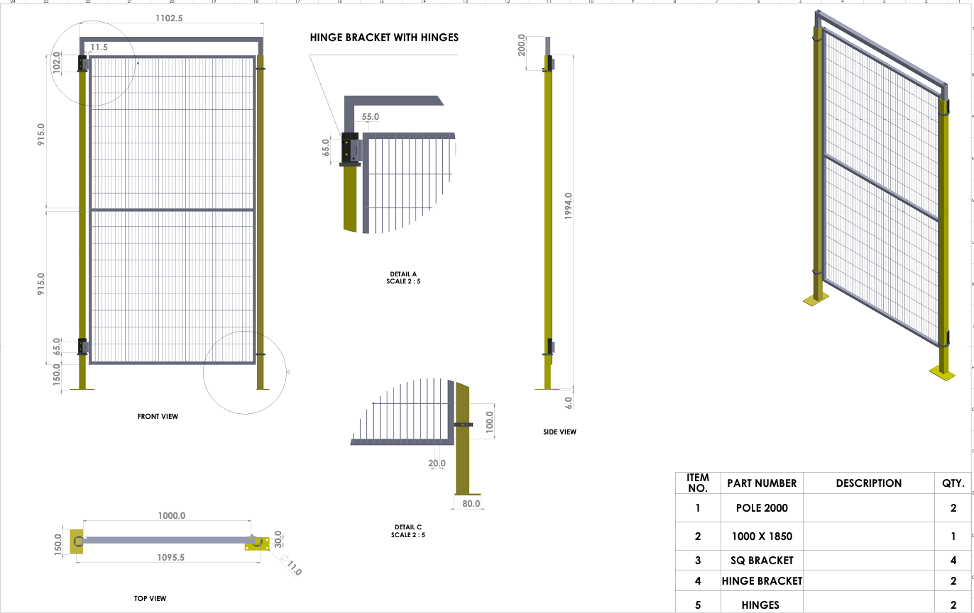
HINGE DOOR ASSEMBLY
Start and release
New products releases
Certificates and Achievements
www.machinessafety.com
Page 13 of 16

Slide 14
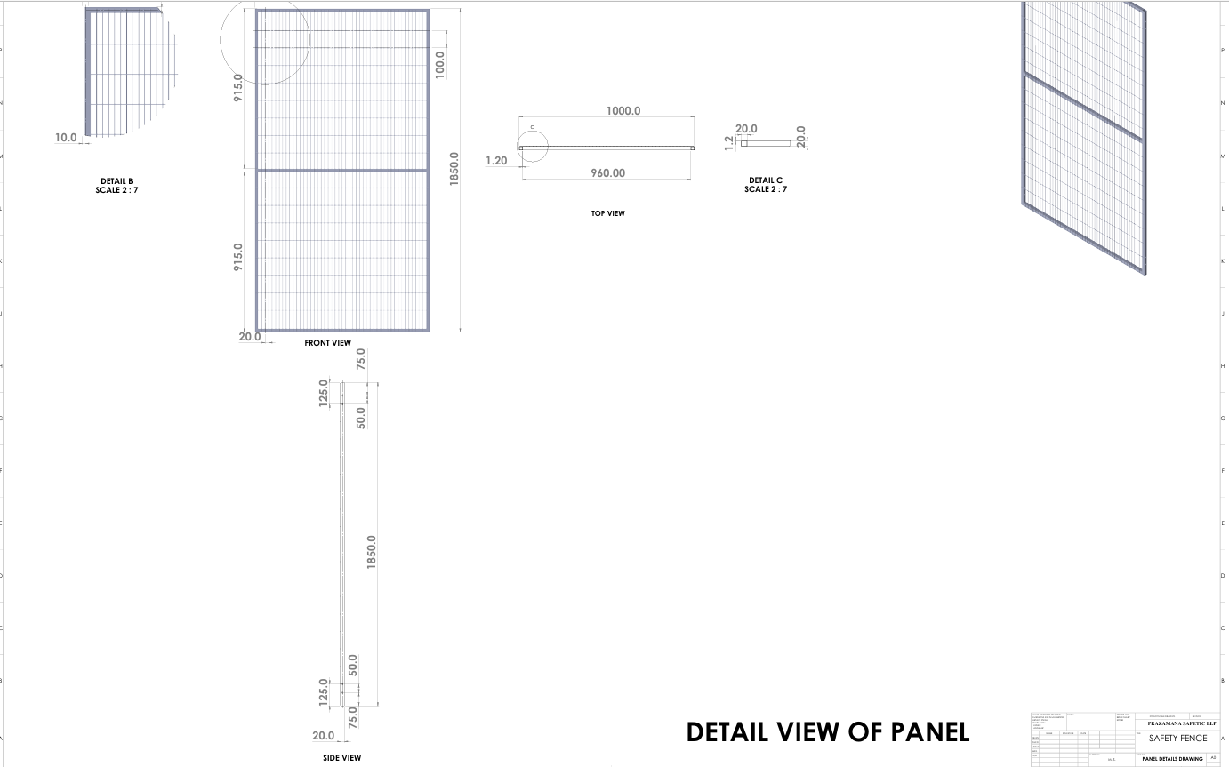
FRAME DETAILED DRAWING
Start and release
New products releases
Certificates and Achievements
www.machinessafety.com
Page 14 of 16

Slide 15















KEY CUSTOMERS
www.machinessafety.com
Page 15 of 16

Slide 16




CONTACT US
THANK YOU
316, 3rd Floor, Xion Mall,
Hinjewadi, Pune-411057,
Maharashtra, INDIA
+91-9925100410.
Mahesh_gaur@prazamana.in
We look forward to working with you
www.machinessafety.com
www.machinessafety.com
Page 16 of 16

